Slide 1
DATA STRUCTURE
LINKED LIST

Slide 2
Linked List
It’s a linear data structure where elements are stored in nodes and each node points to the next node in the sequence is known as Linked list.
It doesn’t store elements in contiguous memory location.
It allows dynamic memory allocation.
It makes insertion and deletion operations more efficient compare to array.

Slide 3
# Node
Which consist of two parts
Data: That holds the value.
Pointer: That points to the next node in the list.
EXAMPLE
Struct node
{
int data;
struct node* next;
}

Slide 4
Advantages
Dynamic Memory list
It allocate memory dynamically. It is allocated only when needed.
2. Efficient Insertion and Deletion
The operations are efficient.
3. No predefine size
It is not constrained by fixed size.
4. Efficient Memory Usage
The amount of memory required for the element is allocated, which is particularly beneficial when dealing with large data sets.
5. Flexibility
It provides more flexibility.

Slide 5
Disadvantages
Memory Overhead
Each node requires extra memory to store the pointer to the next node.
2. Slower Access Time
It do not provide constant-time access to element.
3. Pointer Management
Errors like dangling pointers or memory leaks can occur if not handled properly
4. Cache Locality
Linked list element are scattered in memory, they don’t take advantage of caching as effectively as arrays, where elements are stored contiguously.
5. Complex Implementation
Compared to arrays, implementing linked lists can be more complex.

Slide 6
Types of Linked List
Single Linked List
Which consist of data part and address part. The address part is the node known as a pointer.
Each node points to the next node and the next node point to NULL.
NULL means its address part doesn’t point to any node.
The pointer that holds the address of the initial node known as a head pointer
Struct node
{
int data;
struct node* next;
}

Slide 7
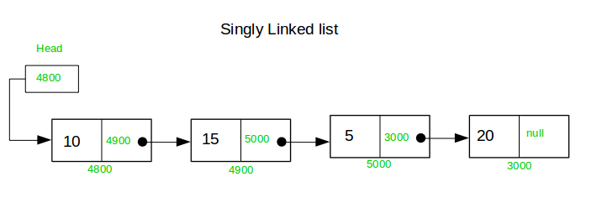

Slide 8
2. Double Linked List
Each node has pointer to both the next and the previous node.
Allow bidirectional traversal.
Struct node
{
int data;
node* next;
node* prev;
}

Slide 9
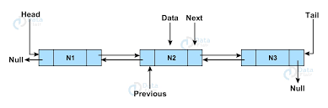

Slide 10
3. Circular Linked list
The last node points back to the first node.
Useful for applications like round-robin scheduling.
Struct node
{
int data;
node* next;
}

Slide 11
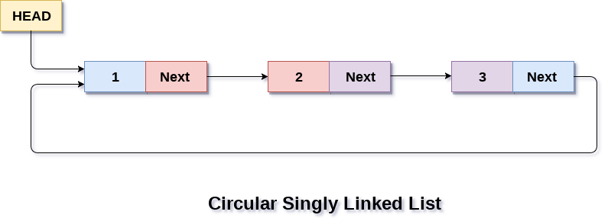

Slide 12
4. Doubly Circular Linked list
Combines features of both circular and doubly linked list.
Each node had pointer to both the next and the previous nodes, and the last node points back to the first node.
Struct node
{
int data;
node* next;
node* prev;
}

Slide 13
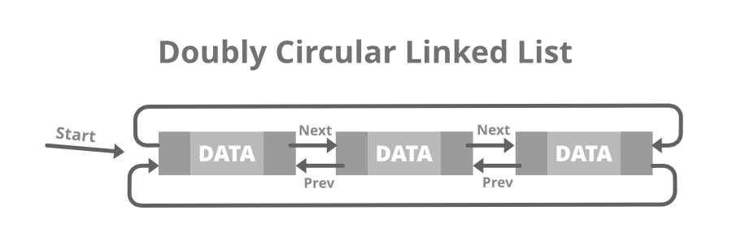

Slide 14
Basic Operation with Its Algorithm
Insertion
Insertion At beginning
Start
Create a new node
Set the new node’s data to given value
Set new node’s next to pointer to the current head
Update the head to print
Stop

Slide 15
Insertion At The End
Start
Create a new node
Set the new node’s data to the given value
Set the new node’s next to Null
If the list is empty, set the head to point to the new node
Else, traverse to the last node and set the last node’s next to the new node
Stop

Slide 16
B. Deletion
Deletion at the beginning
Start
If head= Null
write over flow {go to step f }
[ end of if statement]
Set prt= head
Set head= head_> next
Free prt
Exist

Slide 17
II. Deletion at the End
Start
If head= Null
write overflow { go to step }
[end of the if statement]
Set prt=head
Repeat step d and e;
while ptr_>next!=Null
e. Set pre ptr=ptr
f. Set ptr= ptr_>next {end of loop}
g. Set pre ptr_>next= Null
h. Free ptr
i. Exist

Slide 18
C. Search Operation
The search operation is used to search a particular node in a given list.
We match each element of the list with the given element. If the element is found in any of the location/ address of the element is returned otherwise Null is returned.

